Slide 1
Introduction to synthesis
Developed by Tamara Hanford Scholtz

Slide 2

What’s going on in this image? Check out the image below and come to a conclusion. Try to explain as much as you can about the who, what, where, when just by looking at the clues. You are synthesizing information to develop a position.
List your clues here:
List your conclusions here:
Who?
What?
When?
Where?
Click here for answer, but don’t cheat. It’s more fun if you don’t!

Slide 3
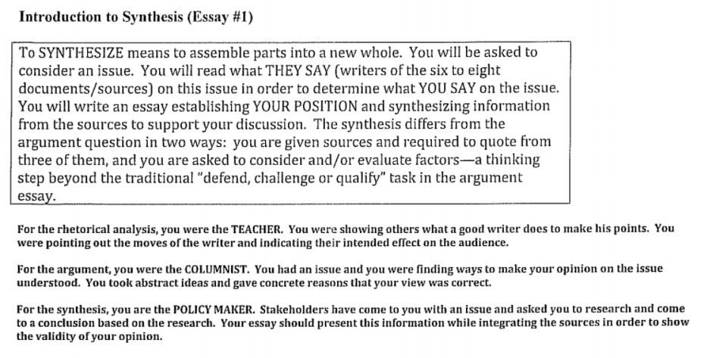

Slide 4
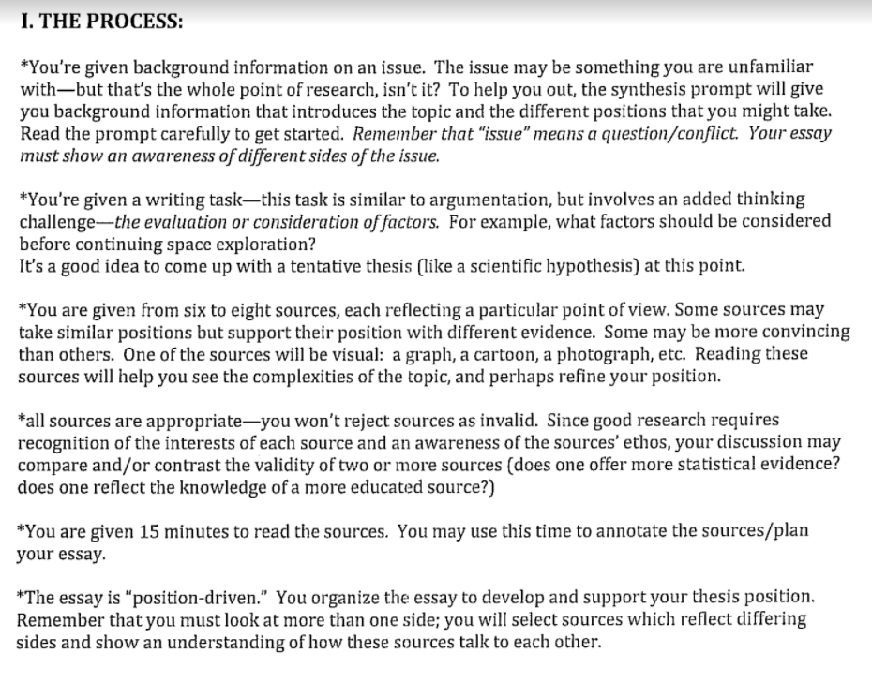
can involve

Slide 5
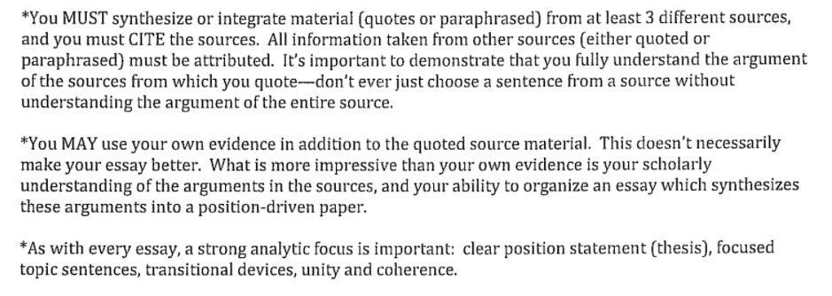

Slide 6
What the Prompt Tells You
It can help you understand the topic, see both sides of this issue and recognize factors/implications. Then, you can figure out how you MIGHT organize your paper BEFORE you begin the read the sources
**This is imperative. You need to make sure that YOU are driving the argument. The sources are your support, NOT the other way around. You need to be sure you don’t give a “tour of the sources.”

Slide 7
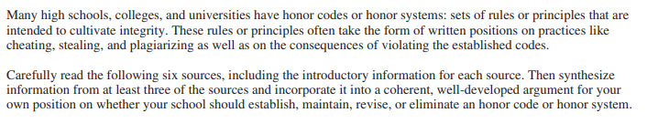
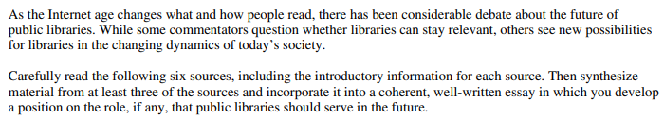
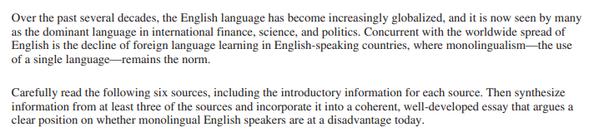
Pick a prompt, any prompt… Choose one of the three prompts below to work through the rest of the slideshow. (I know you don’t have the sources, I don’t want you to have them, yet. I want you to develop a position first.) Move this checkmark beside your chosen prompt. (You’re not going to write the essay. You’re just going to prewrite for now).

Slide 8
What is the prompt? Put this in your own words. What are you supposed to develop a position regarding? Write yourself a question the prompt needs you to answer. You will answer the question in your thesis statement.
Example: What is my position on what factors we should consider before engaging in space exploration? (see full prompt here)
What is my position on reorganizing the post office?(see full prompt here)
Question here:

Slide 9
Who are my stakeholders? Who will my audience be? Who would care about the position I’m making for my prompt? Your stakeholders will help you determine the factors for your argument. You must be thinking about what would matter to your audience.
Examples:
For space exploration: tax payers, astronauts, scientists, the government, researchers, competing countries would all care.
For post office: post office workers, other shipping companies, the American public (especially older people), the government would all care.
Answer here:

Slide 10
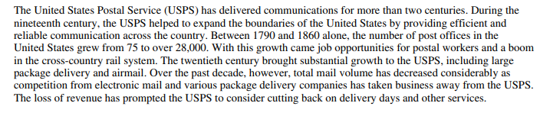
What hints or helpful information can I find in my prompt that may help me decide on my position? (You will find this in the FIRST paragraph on your prompt.) Summarize the information; then, think of how it could help you come to a decision about your position.
Example:
Summary: Post office is 200 years old. It used to employ lots of people, and it grew very rapidly. But other companies have caused it to start decreasing because of competition in the last decade.
So what ?: There is a history and a nostalgia and some employment involved, but it could be time to restructure in some way because it is not as necessary anymore.
Your turn:
Summary:
So what ?:

Slide 11
At this point, what is a possible position I might take? I realize that reading the sources may give me some different ideas, but I want to go into the sources with some direction. What concrete issues might I consider? What would your stakeholders care about? Keep your audience in mind.
$SEEITT
$ consider economic issues such as costs, jobs, and other financial issues
S represents SAFETY (health and medical issues)
E stands for ETHICS (values, morals, beliefs)
E symbolizes the ENVIRONMENT (natural, political, or social)
I equals INTERNATIONAL IMPACT
T stands for TECHNOLOGICAL ISSUES
T represents TIME

Slide 12
EXAMPLE!
Issue | yes/no | How might the issue matter?
$ | yes | If the post office were restructured, people might lose their jobs, but it may also cost the government less money.
S | no
E | yes | People have a big sense of nostalgia and the start of the post office is something that is essentially American and everyone has access to it.
E | yes | Less trucks driving around could be good. But what would happen with all of the old buildings and all of the old trucks?
I | no
T | yes | Since email and online ordering there is less need for the post office and more complications with ordering things.
T | yes | Things like Fed/Ex and other privatized delivery services can be much more competitive than a government funded agency with regard to time.

Slide 13
Retype or paste your prompt here:
YOUR TURN!
Issue | yes/no | How might the issue matter?
$
S
E
E
I
T
T

Slide 14
If you had to write a thesis right now, what might it be? (I understand you don’t have sources or ideas, yet… but I want your argument to guide your essay, NOT the sources.) Go back to slide 8. Answer that question for your thesis. Keep your audience and issues in mind.
Example: Because of the recent decline in the public’s use of traditional mail services, the post office should reorganize themselves in a way to be a competitor with the private shipping companies.
Your turn:

Slide 15
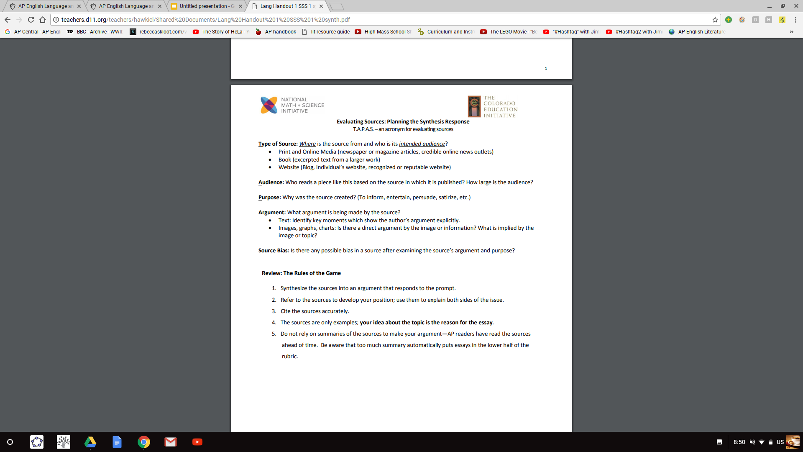
First, look at your sources including introductory information; don’t forget your TAPAS
This will ALWAYS matter. When you’re looking at sources, you need to keep in mind who produced them, what is their intention? This is evaluating SOAP. Sophisticated writers will address this in the conversation between the sources.
**Thanks to Frances Bracamonte

Slide 16
Now, read through the whole prompt and the passages. See if you find things that would support your argument. Do you find things that would go against your argument? Try to find sources that may talk to each other… You MUST use at least 3. Do this with a “Ctrl F”mentality. You are looking for things to use to support your argument. You are not doing a detailed analysis of the sources.
Public library full prompt
Honor code full prompt
Monolingualism full prompt
Which sources could you use? (List the letter here) | How would you use it to support your argument? (Remember, you may want to include a counter argument that you will refute.) | Anything about the sources you might want to challenge? Or have other sources challenge? (Consider the TAPAS. This is not necessary, but may make your argument more sophisticated.) | Any specific quotes you might incorporate? (You don’t want more than about 5-10 words in your quote.)
(optional)

Slide 17

Consider hexagonal thinking
Trying for that unicorn point? Consider how your sources might relate to one another. It’s not NECESSARY, but it can strengthen your essay. Take a look at this graphic, and try it out with your sources.

Slide 18
Thesis revisited: Go back to your thesis. Are there changes now that you have read through sources? Rewrite below, or if you’re happy with your original, paste it here again.
My thesis: The post office needs to reorganize in order to become a competitor with other delivery companies by downsizing their number of offices, updating their technology, and rebranding as an affordable shipping company. **note**: Can you see how if I were to use this for my paper it would show my line of reasoning? Do you see the paragraphs I would have? You don’t HAVE to do it that way, but you sure can...
Your turn:

Slide 19
THE PROCESS OF PLANNING AND WRITING A SYNTHESIS ESSAY (55 minutes)
I. UNDERSTAND THE PROMPT (5 minutes)
II. GET INFORMATION FROM THE SOURCES (10 minutes)
While reading the sources, mark (+) for things that may support your argument (–) for things that you may use as a concession. Underline any SUPER quotes or blurbs. Your quotes should never be more than about five words long, but it something is said well, USE IT. Approach with the “Ctrl F” mentality.
III. PLAN YOUR ESSAY (8 minutes)
1. Revise your thesis statement. Can you think of an anecdote to lead into it?
2. Briefly outline your support paragraphs--remember to begin with a topic sentence reflecting your position.
In a synthesis essay, you should always consider opposing views
*Where will you include each source?
*What additional evidence could you include?
3. Remember that your ability to show a conversation between the sources is evidence of more complex thinking.
*Where could you include two sources that both support a particular position
*Where could you evaluate two or more sources that address the same issue?
*How could you contrast two sources that show differing views?
IV. WRITE YOUR ESSAY/PROOFREAD (32 minutes)
1. Introduce issue in an interesting way. 5. Include original commentary, insights
2. Follow your planned outline. 6. Write a strong conclusion (however brief)
3. Use language of concession/transitional devices.
4. Provide a frame for your quotes from different sources
No, you do not have to write the essay today, BUT I want you to think about how you would organize it if you did! Remember, it’s a smoothie, not a salad...

Slide 20
Take a look at the high scoring essay for the prompt you chose, and fill out the reflection:
Honor code
Monolingualism
Public libraries
What did you notice that made the essay good?
In what ways was it similar to what you may have planned?
In what ways was it different?
What did you learn by your exploration?

Slide 21
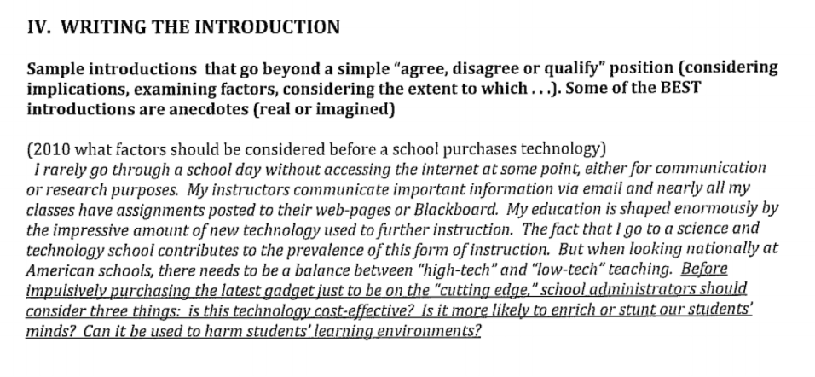

Slide 22
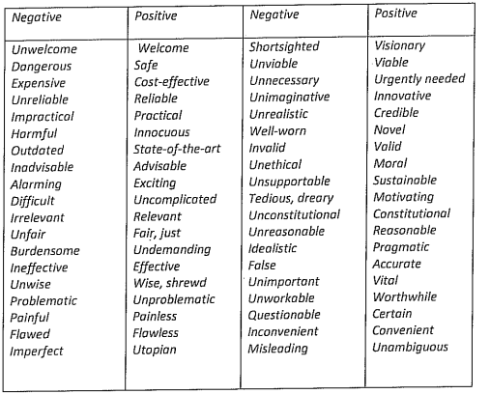
POLICY VOCABULARY

Slide 23
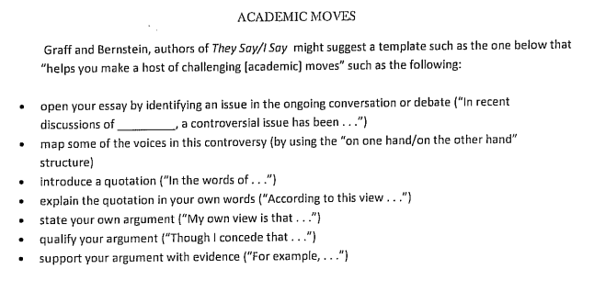
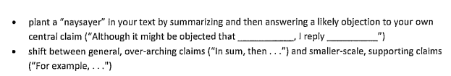

Slide 24
So that’s it in a nutshell. That’s how you do the essay. The next assignment is to try a fun one before we dive into the real thing… When you need writing reminders, see your digital notebook.
Need more help? Try these videos:
Coach Hall Writes has a fantastic channel with videos.
Matthew Singleton has a GREAT YouTube channel with lots of help. These are a little dated and based on the 9 point rubric, but the essays were the same.
And Timm Freitas. All things “Garden of English “ are super helpful.

Slide 25

Slide deck created by Tamara Scholtz, East View High School, Georgetown, Texas (derived from more than a decade of AP Lang resources begged and borrowed - hopefully not stolen - from the amazing AP Lang community).
scholtzt@georgetownisd.org

